Slide 1
AI for Firefighters
Team Mango Tango
Sophia Carney, Yi Gu, Cordelia Ludden, Davae Lynch, Aryaa Modi
Notes:
Yi

Slide 2
Overall Project Goal:
Overall Project Goal: Use LiDAR to scan a building and create a comprehensive dashboard that displays windows, doors, and firefighters on the building map. This will help the fire commander control the situation inside the building as the firefighters respond to an emergency.
Notes:
Yi

Slide 3
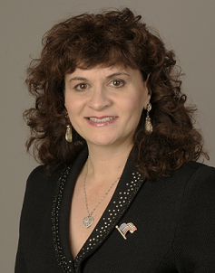

Our Sponsor
Boston Fire Department
Dr. Karen Panetta &
Vision and Sensing Systems Lab
Notes:
Yi

Slide 4
Problem We Solved:
Get LiDAR to output x, y, z coordinates from a single frame and clean this data to be fed into an AI program. This AI program will predict which points belong to walls, windows, doors, etc. and output the accuracy rating of the model.
Notes:
Davae
explain how this ties into larger project goal

Slide 5
Our Requirements:
Get LiDAR working to process Point Cloud data
Build an AI model to take in point cloud data and identify if points belong to walls, windows, doors, etc.
Make sure device is wearable and does not impede firefighter’s job
Make sure device is heat and water resistant.
Notes:
Davae

Slide 6
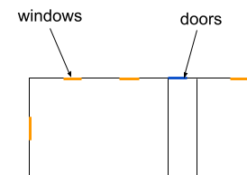
MVP - (Data pipeline)
LiDAR Team Code
Pointnet++ Team Code
Output Data
LiDAR takes in raw coordinates of one frame while stationary
Data goes through LiDAR team’s code to process the data into xyz coordinates to feed into AI model
Data goes through pointnet++ AI model to categorize points as walls, windows, and doors. It then outputs which points belong to a window door or wall with accuracy probabilities
Point cloud with accuracy rating of wall window and door detection
Notes:
Cordelia

Slide 7
System Architecture:
Point cloud data (UDP)
Stanford Point Cloud Dataset
LiDAR
ROS 2
Trained with semantic dataset and pytorch
Point cloud data (x, y, z)
frame_inspector
Library
(LiDAR team)
Pointnet++ Model
(AI team)
Output Data
Notes:
Cordelia
Mention here our interface is the laptop and command line

Slide 8
Acceptance Test Results:
Test 1: Device must be able to accurately map a building
Fail
Test 2: Device must be wearable and non intrusive to the firefighters normal activities
Pass
Test 3: LiDAR must be able to transmit frame by frame data into AI model
Pass
Test 4: LiDAR can process multiple frames in relation to one another
Fail
Notes:
Cordelia

Slide 9
Acceptance Test Results:
Test 5: The AI model must be able to accurately perform wall, window, and door detection. It should be tested with an unseen environment and avoid overestimating performance
Fail due to lower than desired accuracy score
Notes:
Davae
The model has an overall detection accuracy of 62%
The model's mIoU value is 17%, with unknown classes performing particularly well.
The model’s mAcc value 37%, with unknown and ceiling classes performing well.
This result may be attributed to the dominance of several majority classes like unknown, clutter.

Slide 10
Subteam Tasks/Timeline
LiDAR Team
AI/PointNet++ Team
Download ROS2 and SDK
Connect LiDAR to receive packets over the network
Add a package to the SDK to process frames in real-time
Work with the IMU to connect it
Preprocess mesh to point level data
Partition dataset into blocks
Build PointNet++ using Pytorch and train model
Test with various metrics
Iterate to improve model
Notes:
Aryaa

Slide 11
Ethics/Social Impact
Since firefighters will be using our product during emergencies, we need it to be safe to use
If the dashboard shows a door or window where there isn’t one, the commander will think there is an exit when there is not
We would rather have false negatives than false positives - we don’t want to detect windows and doors where there aren’t
Handing over a bad product for firefighters to use could cost them lives, so quality is extra important
Notes:
Aryaa

Slide 12
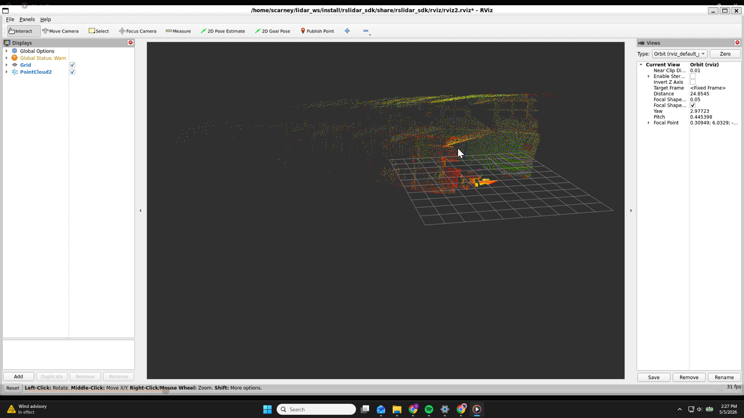
Demo - LiDAR
Live frame-by-frame scan of 574 Boston Ave 4th floor
Notes:
Sophia

Slide 13
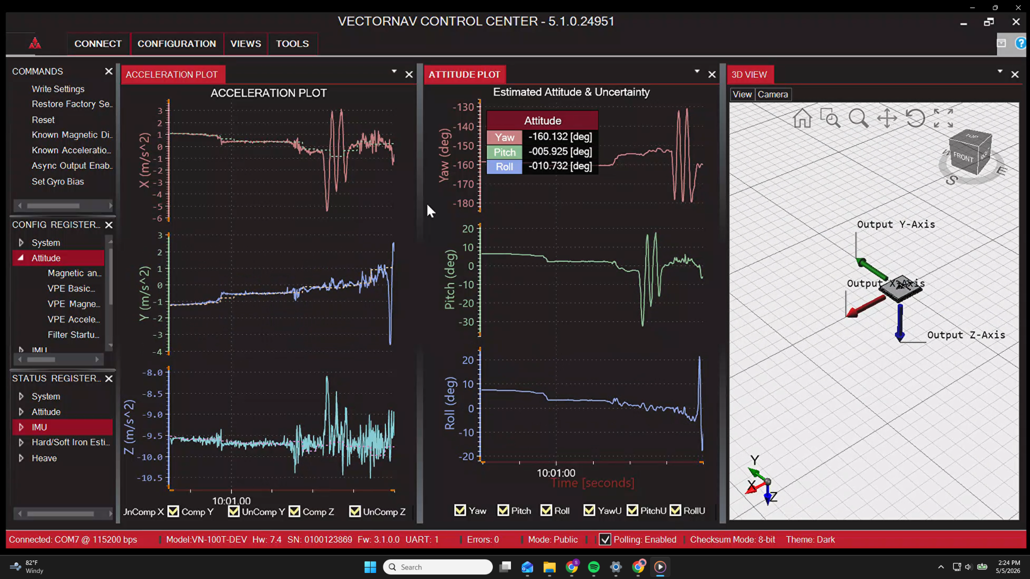
Demo - IMU (tracking device)
3-axis linear acceleration (ax, ay, az)
3-axis angular velocity (not shown)
Orientation (yaw/pitch/roll)
Notes:
Sophia

Slide 14
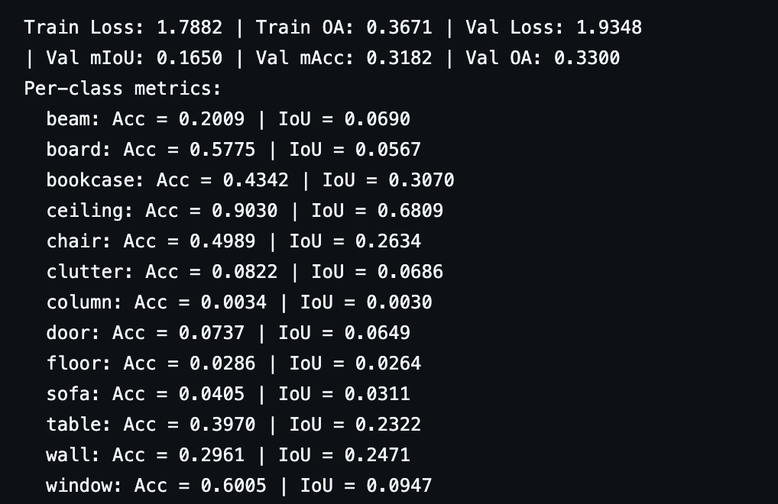
Demo - AI
Notes:
Yi

Slide 15
What we learned
We learned how to alter our project goals based on time and technology constraints
Our MVP changed multiple times throughout this project
We learned the importance of splitting tasks to get more work done simultaneously
When one team is blocked by something, they can help out the other team
Notes:
Aryaa

Slide 16
Next Steps
Integrate LiDAR with IMU to create a point cloud of an entire building
Pipe LiDAR data into the AI Model to see if doors, windows., walls are accurately detected
Improve the accuracy results of the AI model by doing more training
Doors + windows currently have lower accuracy than we would like it to
Test the model with LiDAR data representative of actual fire/emergency conditions (in a smoky environment)
Create the dashboard that highlights where doors, walls, windows are on a building map
Notes:
Sophia

Slide 17
Questions?

